Slide 1

Electronic Devices
Lab Lecture 5
This document might contain some excerpts and pictures from various books and other sources. The author doesn’t claim any rights to the topics discussed in this video. This topics has been presented in a way to help out students in BRAC university, Bangladesh

Slide 2
Triangular Wave Generator
The objective of this experiment is to analyze a triangular wave generator.
So basic logic is that first we will generate a square wave .
A square wave can be generated using a Schmitt trigger circuit.
Now from the basic logic of mathematics , we know that differentiating a square signal results in triangular signal .
So we used an op-amp integrator to integrate the square signal.

Slide 3
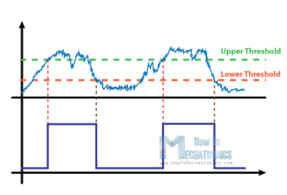
Schmitt Trigger
A Schmitt Trigger is a Bi-stable Multivibrator and its output remains in either of the stable states indefinitely.
For the output to change from one stable state to other, the input signal must change (or trigger) appropriately.
For example, if we have a noisy input signal as shown right side, the two thresholds of the Schmitt Trigger Circuit will correctly determine the pulses. Hence, the basic function of a Schmitt Trigger is to convert noisy square, sine, triangular or any periodic signals into clean square pulses with sharp leading and trailing edges.

Slide 4
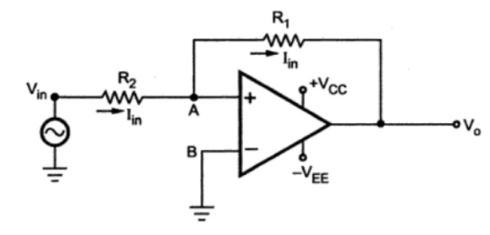
Schmitt Trigger
In non-Inverting Schmitt Trigger the input is applied to the non-inverting terminal of the Op-Amp. The output voltage is fed back to the non-inverting terminal through the resistor R1.
Let us assume that initially, the output voltage is at V_{SAT}. Until V­_{IN} becomes less than V_{LT}, the output stays at this saturation level.
Once the input voltage crosses the lower threshold voltage level, the output changes state to -V_{SAT}
The output remains at this state until the input rises beyond the upper threshold voltage.

Slide 5
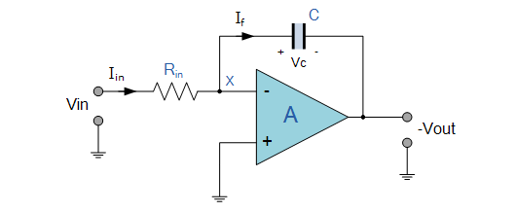
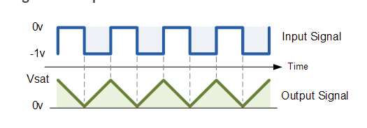

Integrator
Op-amp Integrator is an operational amplifier circuit that performs the mathematical operation of Integration

Slide 6
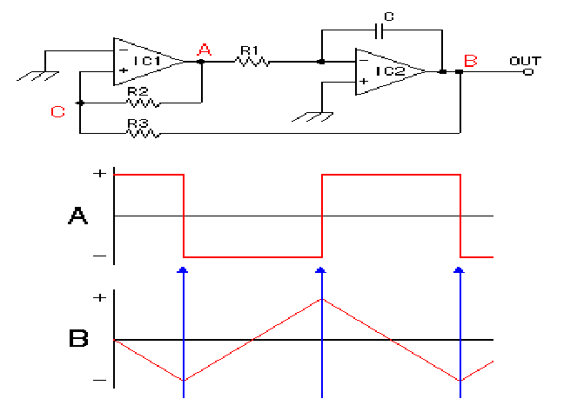
Triangular Wave Generator
IC1 is the Schmitt circuit and IC2 is the integration circuit.
Let’s assume A becomes positive saturated voltage.
So current flows towards the capacitor C through the resistor R1.
Electric charge begins to store up at the left side of the capacitor so capacitor voltage started increasing.
At the same time output of the IC2 (B point) Falls gradually.

Slide 7
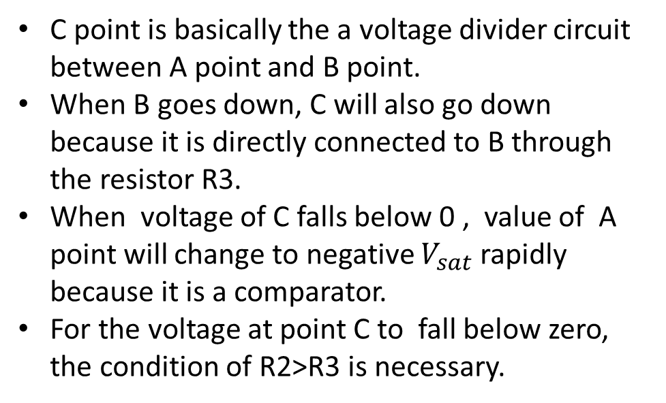
Triangular Wave Generator
C point is basically the a voltage divider circuit between A point and B point.
When B goes down, C will also go down because it is directly connected to B through the resistor R3.
When voltage of C falls below 0 , value of A point will change to negative $V_{sat}$ rapidly because it is a comparator.
For the voltage at point C to fall below zero, the condition of R2>R3 is necessary.

Slide 8
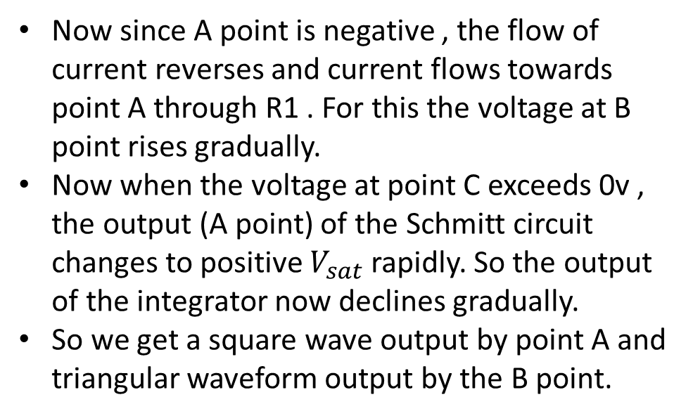
Triangular Wave Generator
Now since A point is negative , the flow of current reverses and current flows towards point A through R1 . For this the voltage at B point rises gradually.
Now when the voltage at point C exceeds 0v , the output (A point) of the Schmitt circuit changes to positive $V_{sat}$ rapidly. So the output of the integrator now declines gradually.
So we get a square wave output by point A and triangular waveform output by the B point.

Slide 9
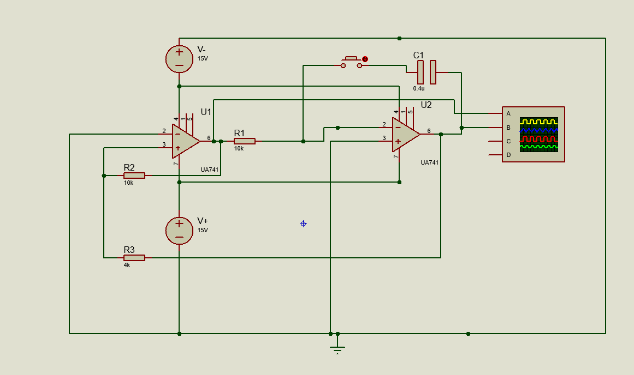
Simulation
Figure : Schematic of Triangular Wave generator circuit.

Slide 10
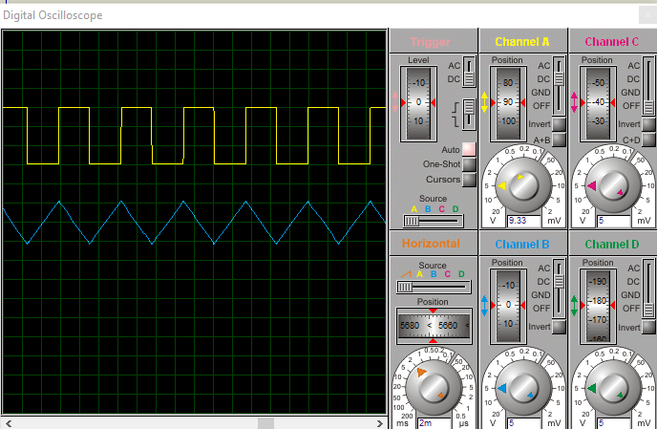
Simulation
Figure :Oscilloscope output

